Slide 1
PHARMACY MANAGEMENT SYSTEM
Under The Guidance Of
Prof. Bahirat M.R
Submitted by :Yelwande Pranoti Kiran.

Slide 2
ABSTRACT:
The Pharmacy Management System is a desktop application designed to streamline and enhance the operations.
The main goal is to automate the existing manual system with the help of Computerized equipment.
The Pharmacy Management System is a technologically advanced solution designed to revolutionize the way pharmacist manages their work.

Slide 3
INTRODUCTION :
In an era where security, efficiency, and user experience are paramount, this system offers a comprehensive set of features aimed at addressing the shortcomings of traditional Pharmacy management processes.
The Pharmacy Management System is a Desktop Application that will help to manage the database of the pharmaceutical shop.
The user interface prioritizes simplicity and efficiency.

Slide 4
PROBLEM STATEMENT:
Emergency Preparedness:
In the event of emergencies, Pharmacist may encounter difficulties in swiftly and accurately accounting.
Data Accuracy:
Accurate records can lead to effective decision-making.
Lack of Adaptability:
Traditional systems often struggle to adapt to changing security needs and technological advancements.

Slide 5
PURPOSED SYSTEM:
The main purpose is effectively and easily handling of pharmacy data and its management.
It will provide detailed analytics for better decision-making.
Improving the overall experience is a key objective.

Slide 6
SCOPE OF PROJECT:
It may help collecting perfect management in details. In a very short time, the collection will be obvious, simple and sensible.
It will help a person to know the management of passed year perfectly and vividly.
It also helps in current all works relative to Pharmacy Management System.

Slide 7
The main aim of the project is the management of the database of the pharmaceutical shop.
Data is securely stored, adhering to data protection and privacy regulations to maintain the integrity and confidentiality of information.

Slide 8
ADVANTAGES AND DISADVANTAGES:
ADVANTAGES :
It helps to keep records as well as makes easier to add new records.
Pharmacist can easily retrieve historical data for audits, analysis, or compliance purposes.
It allocates resources more efficiently based on data provided by the system.
DISADVANTAGES:
Initial implementation costs, including hardware, software, and training expenses, can be significant.
It may initially resist adapting to the new system, causing a temporary disruption in workflows.
Regular maintenance and updates.

Slide 9
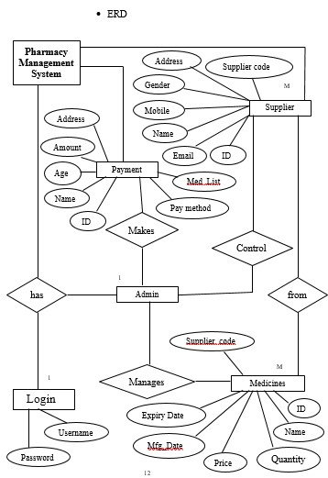
SYSTEM DESIGN:

Slide 10
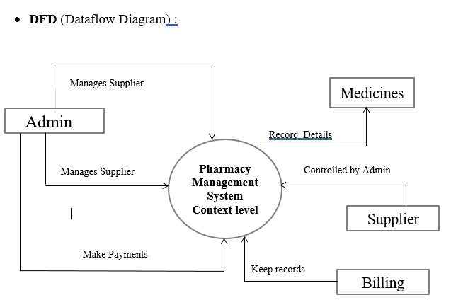

Slide 11
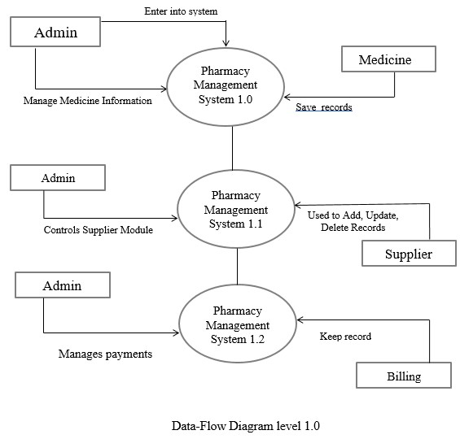

Slide 12
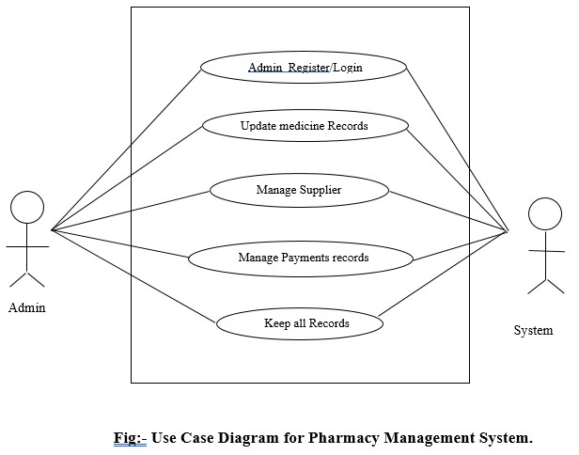

Slide 13
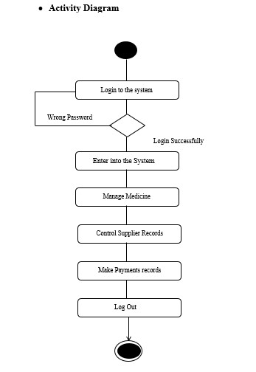

Slide 14
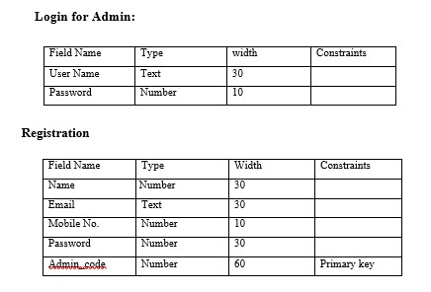
DATA DICTIONARY:

Slide 15
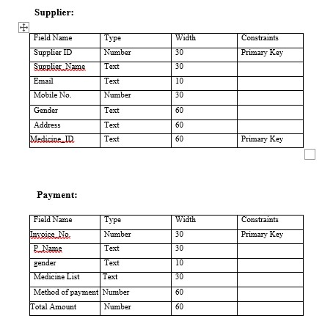
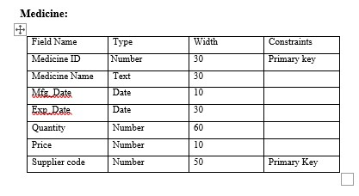

Slide 16
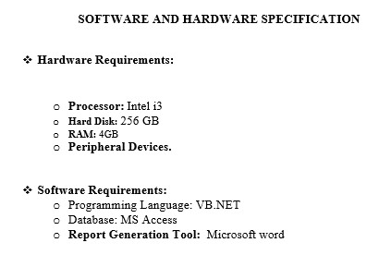

Slide 17
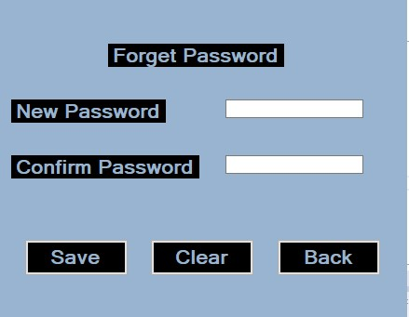
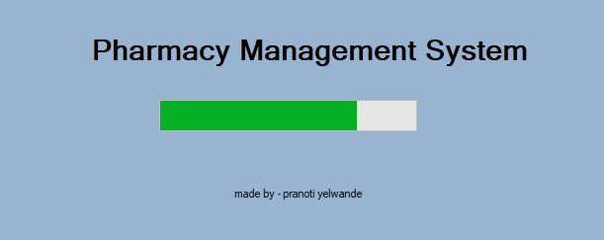
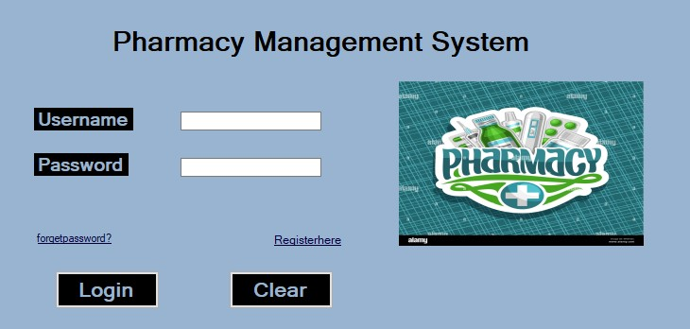
OUTPUTS:

Slide 18
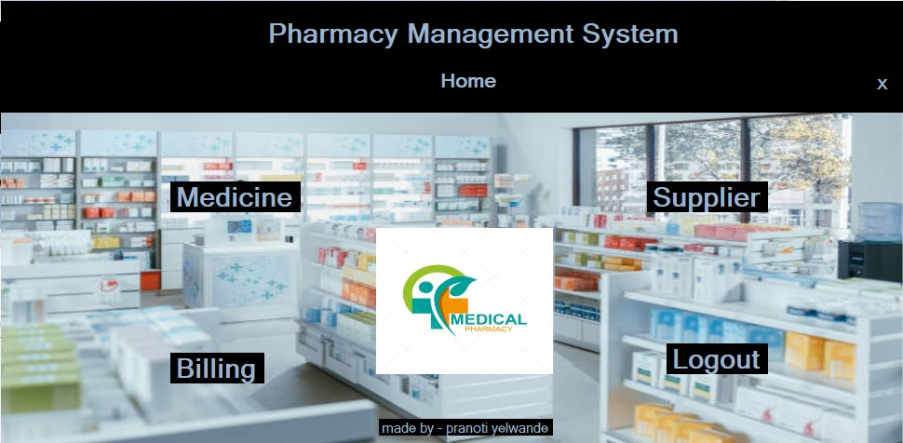

Slide 19
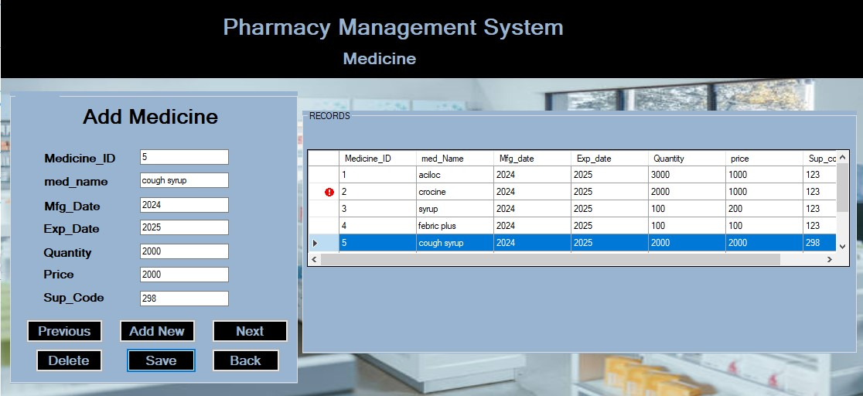
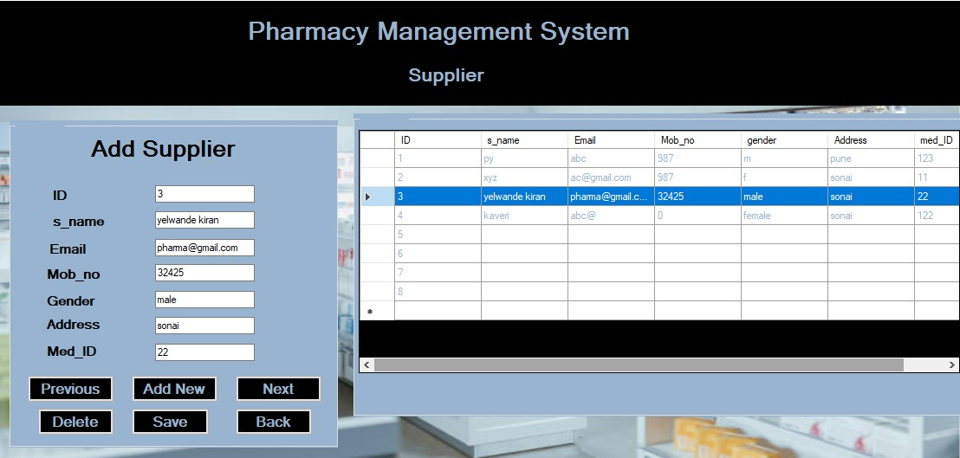

Slide 20
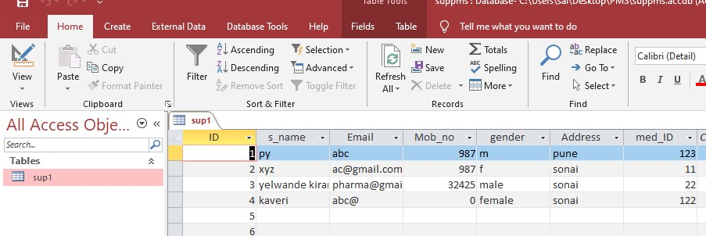

Slide 21
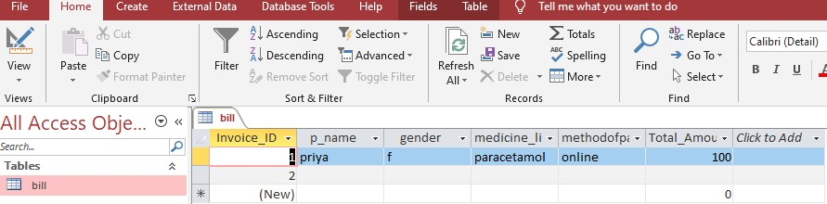
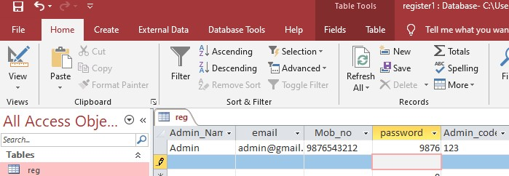

Slide 22
FUTURE SCOPE:
Artificial Intelligence for Automated Approval: Implement AI algorithms that analyze historical data and user patterns to automatically approve routine.
Robotic assistants in certain environments to facilitate the answer queries.
Leveraging data analytics tools can enable pharmacies to analyze population health trends, identify high-risk patient groups, and implement targeted interventions.
By embracing innovation and collaboration, pharmacy management systems will continue to play a pivotal role in the evolving landscape of healthcare delivery.
Besides traditional medication dispensing, PMS can expand its services to include medication therapy management, medication synchronization programs, and comprehensive medication reviews.

Slide 23
CONCLUSION:
Pharmacy management system is actually a desktop application which handle the essential data and save the data and actually about the database of a pharmacy and its management.
A good pharmacy management system should be flexible and scalable to accommodate the changing needs of the pharmacy as it grows. Whether it's adding new services or expanding to multiple locations, the system should adapt to support the evolving business requirements.
In summary, the future of Pharmacy Management Systems holds immense potential for innovation, driven by advancements in technology, evolving healthcare needs, and a focus on improving patient care outcomes.

Slide 24
BIBLIOGRAPHY:
http://www.w3school.com
http://www.youtube.com
https://www.tutorialspoint.com/vb.net/index.htm
https://www.google.com/

Slide 25
THANK YOU

